Slide 1
Opportunity Management Application
Rohit Michael Gonsalves
Under the Mentorship of:
Mr. Rahul Soni (Java Backend)
And
Mr. Pratik Anand (Angular Frontend)

Slide 2
Objective
While using this application, a user must be able to:
Authorise himself with his organizational Mail Id via Google.
View Previously posted Opportunities.
Add new Opportunity/Job postings.
Restricted Edit Existing Job Postings.
View Previous versions of Edited Job Postings
Delete Job Postings.
View Trends on the Active Job Postings.

Slide 3
Tech Stack
Frontend:
Angular 9, TypeScript (Development Framework)
Charts.js (Insights)
Ng2-charts (angular engine for charts.js)
Backend
Java 8 (Development Language)
Spring BOOT(Server and EndPoints) (MVC Architecture followed with Controller, Service, DAO and Repository).
Spring JDBC and JdbcTemplate (Database Access and Querying engine)
PostgreSQL(Database)
JUnit Jupiter 5 + Mockito(Unit testing and Dependency Mocking)
Cucumber + JUnit Vintage Engine(Integration Testing)
Slf4j and LogBack (Logging)
SonarLint for Code Smells

Slide 4
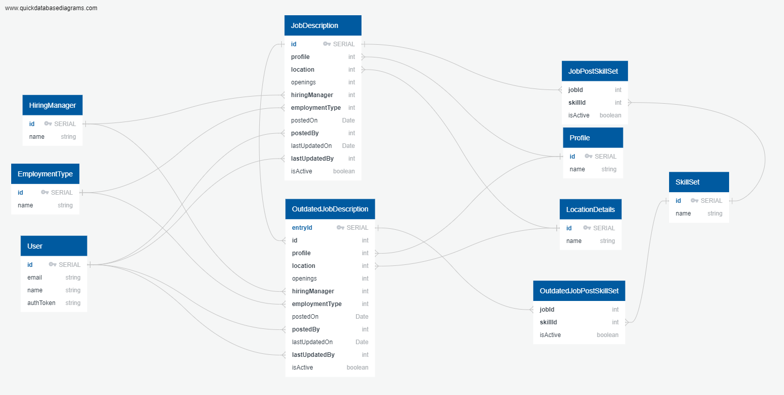
Database Schema

Slide 5

Login

Slide 6
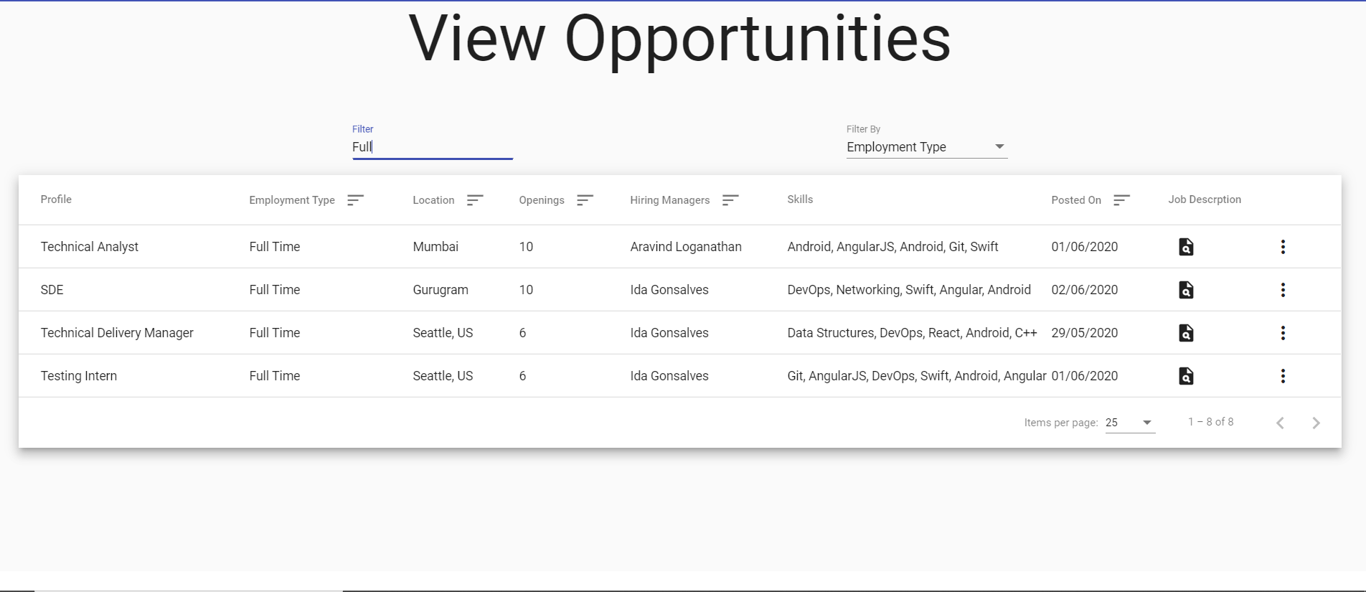
Home Screen

Slide 7
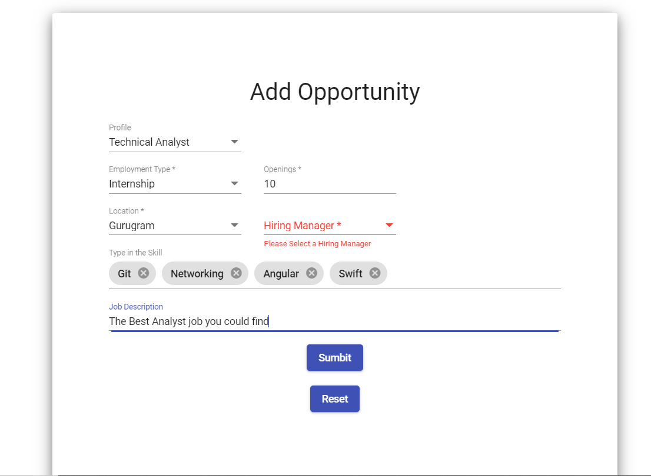
Add/Edit Opportunity

Slide 8
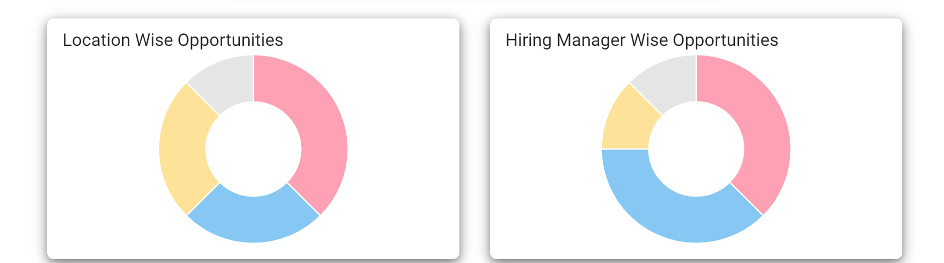
Trends

Slide 9
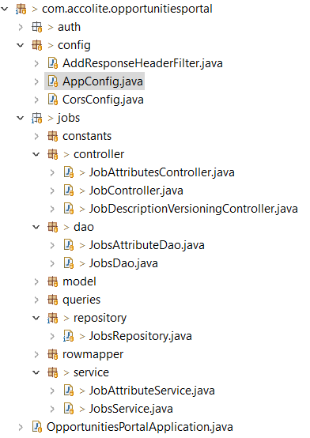
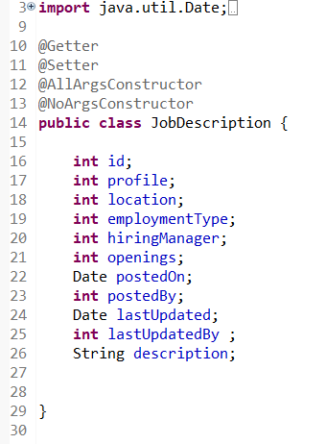
Project Structure, Model Classes and Lombok

Slide 10
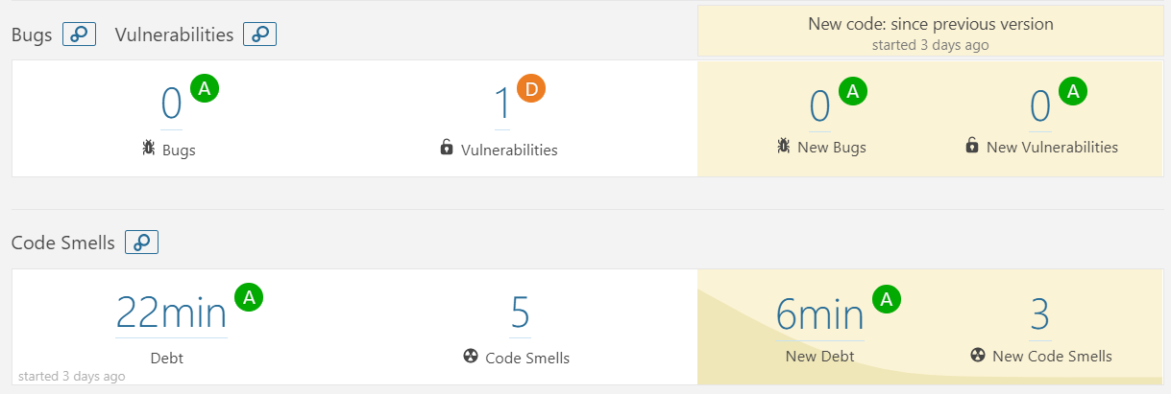
Quality Reporting in SonarQube

Slide 11
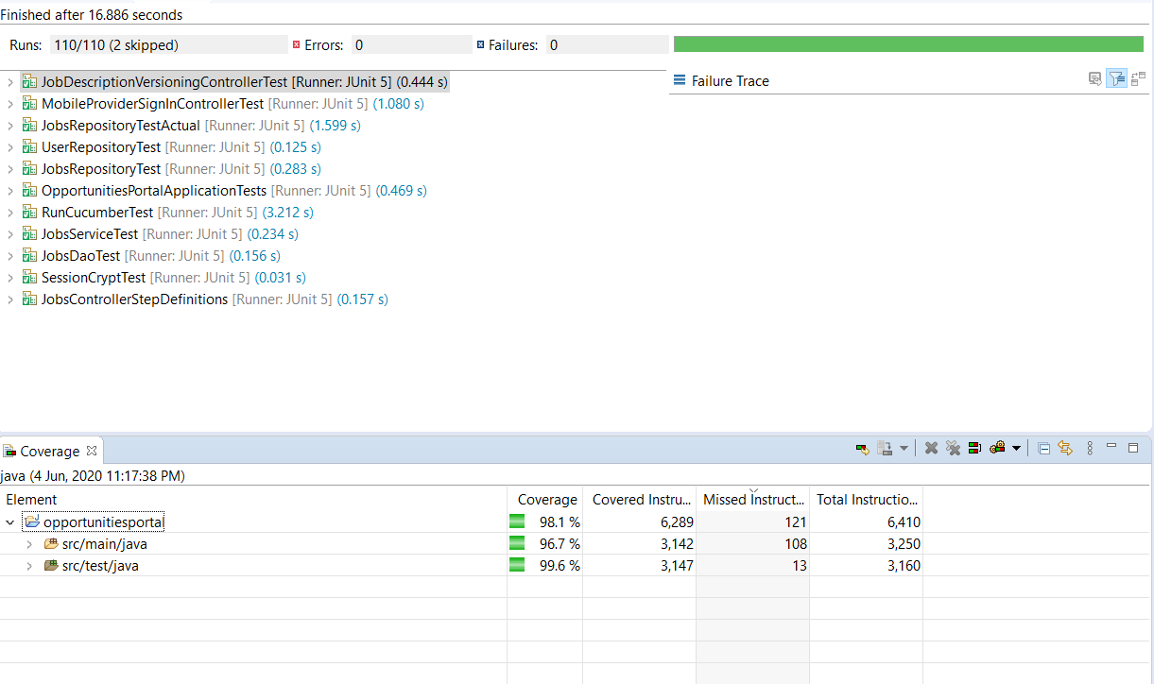
Code Coverage (Unit + Integration Testing) 96.7%

Slide 12
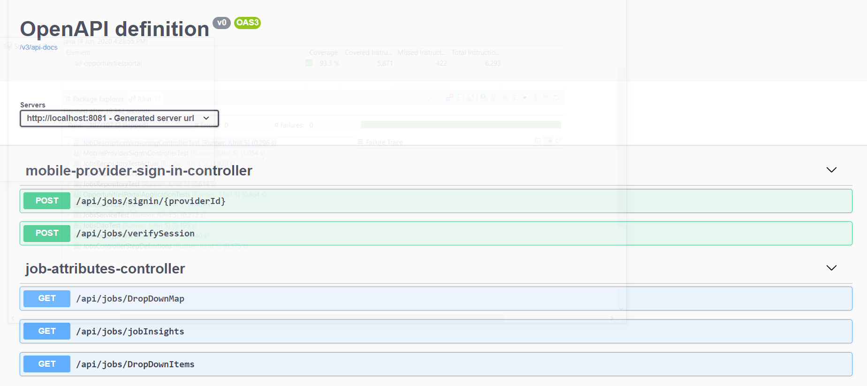
REST Endpoints Documentation using Swagger

Slide 13
Thank You
Checkout my code at:
Frontend:
https://github.com/gonsalvesrohit920/Opportunities-Portal-Frontend.git
Backend:
https://github.com/gonsalvesrohit920/Opportunities-Portal-Backend.git

